Slide 1
Earned Income Credit
Pub 4012 – Tab I
Pub 4491 – Lesson 29

Slide 2
Lesson Topics
EIC Rules
Qualifying child of more than one person
EIC Disallowance in a prior year

Slide 3
Earned Income Credit
Refundable or nonrefundable credit?
Refundable credits can reduce tax liability below $0
Refundable credits entered in payment section
Generate refund even if no tax liability
Notes:
Instructor note: Have volunteer review Pub 4012 to determine if EIC is a refundable or nonrefundable credit. Where can they look?
Even if there is no tax liability (i.e. the taxpayer owes no money), the taxpayer can still receive a check from the IRS.

Slide 4
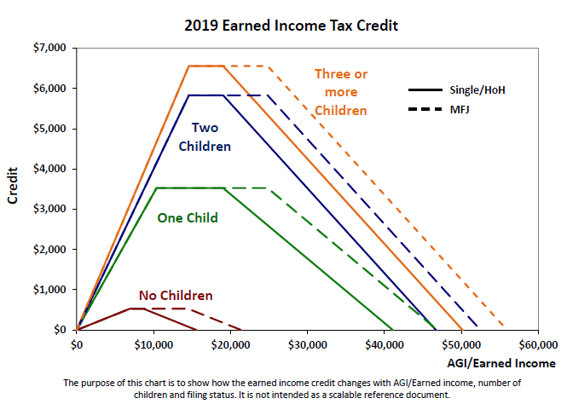
Amount of the Credit
Notes:
EIC applied on bell curve. Little earned income, little credit. Credit increases uphill to a plateau with highest EIC calculated. EIC decreases downhill towards higher income until no longer available.

Slide 5
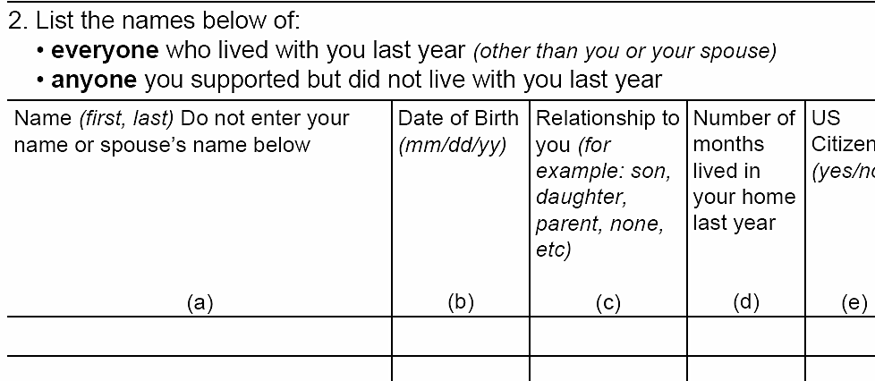
Include All Individuals who Lived in the Home
Include those temporarily away
School
Hospital
Juvenile detention
Notes:
Be sure you find out about ANY family members who lived with them
Avoid questions which require YES/NO answers. Asking who else lived with the taxpayer last year assumes that there will be an answer other than YES or NO.

Slide 6
Earned or Not Earned Income for EIC
Review Pub 4012 Tab I-1: Earned or unearned income?
Disability pension or annuity when taxpayer is under minimum retirements age?
Taxable long-term disability benefits received prior to minimum retirement age?
Nontaxable combat pay?
Taxable scholarship or fellowship grants that are not reported on Form W-2?
Pay for work performed while an inmate at a penal institution or on work release?
Earned – see Pub 4012 Tab D for entries
Earned
Earned if increases EIC/refund
Unearned
Unearned – see Pub 4012 Tab D for entries
Notes:
Note inclusion of long-term taxable disability benefits if under retirement age.
Include combat pay only if including it increases the credit.
Earned Income does not include scholarship income or penal income (or while on work release)
* Software Hint : Volunteers using software must check the box in the Rollover or Disability section of the Form 1099-R input screen to report disability as wages.

Slide 7
EIC Rules
Review Pub 4012 Tab I-2 Summary of EIC Eligibility Rules
Rules for Everyone
Rules if you have a Qualifying Child
Rules if you don’t have a qualifying child
Earned income and AGI limitations
Notes:
Instructor note: Have volunteers open Pub 4012 to Tab I and review the rules. Test their knowledge using the following slides

Slide 8
Eligible for EIC?
Mary is single and has a four year old daughter. She has a W-2 with wages of $23,500.
What if Mary also had a 1099-INT with $2500 of interest in Box 1 and $1300 in box 8 (tax exempt interest)?
Joanne and Mark are filing MFJ and list one dependent, their 12 year old grandson. Their AGI is $40,200 from Social Security and a pension.
Yes
No – Why?
No – Why?
Notes:
Instructor Note: Instructors should present the scenario and have volunteers refer to Pub 4012 Tab I to determine eligibility.
Mary 2 Interest over EIC limit
Joanne and Mark have no earned income

Slide 9
Eligible for EIC?
Mark, 19, is a high school senior who worked last summer and has a W-2 showing wages of $13,987
Martha has $28,978 of earned income. Her husband died four years ago. Her nine year old daughter receives Social Security survivor benefits which provide more than half of her support.
No – Why?
Yes – There is no support test for EIC
Notes:
Instructor Note: Instructors should present the scenario and have volunteers refer to Pub 4012 Tab I to determine eligibility.
Instructors need to be able to answer probing questions from volunteers and there may be more than one reason for answers. For example, is Mark a dependent? Either way he is under age 25 so would not qualify.

Slide 10
Eligible for EIC?
The Clarks are filing MFJ they have two children ages 6 and 9. They have two W-2s showing $48,600 in wages and a W-2G with $6,000 lottery winnings.
James and Kathy live together and are married. Each work and have wages of $21,000 and $23,400. They have two children ages 8 and 11. They wish to file separate returns and each will claim one of the children.
No – Why?
No – Why?
Notes:
Instructor Note: Instructors should present the scenario and have volunteers refer to Pub 4012 Tab I to determine eligibility.
Clarks $52,493 income limit MFJ with 2 QC
James and Kathy No EIC – MFS. Instructors can ask “what if” questions. For example, what if James and Kathy did not live together. Note volunteers may ask if they do live together.

Slide 11
Eligible for EIC?
Mark is a single self-employed painter. He had a net income of $36,986 last year. His sister died in August last year and he became the guardian of her 6 year old daughter who lived with him the rest of the year.
James and Kathy are married, each work and have wages of $21,000 and $23,400. They adopted two children ages 8 and 11 and brought them home in August from Brazil.
No – Why?
No – Why?
Notes:
Instructor Note: Instructors should present the scenario and have volunteers refer to Pub 4012 Tab I to determine eligibility.
QC lived with taxpayer less than 6 months. Instructors can ask “what if” questions. For example, what if Mark’s sister died in February?.
James and Kathy child must have lived in the states more than half the year

Slide 12
EIC Calculation
Credit calculated on whichever amount generates smallest credit
Earned income – or –
AGI

Slide 13
Qualifying Child of More than One Person
Qualifying child of more than one taxpayer – only one can claim EIC with that child
Follow tie-breaker rules
Taxpayer with qualifying child used by someone else can claim EIC with different child – or –
Taxpayer can claim EIC without a child
If all other rules met
Notes:
Tie-breaker rules used to be applied only if two or more people claimed the same child.
Taxpayer Relief Act of 2009 changed that.
Tie-breaker rules now apply all the time—except that either parent (with whom child lived more than ½ the year) can claim the child.

Slide 14
Qualifying Child of More than One Person
Tiebreaker rules: more than one taxpayer can claim a child
Only one the parent, parent wins
Both parents can claim child, custodial parent wins
Child in custody of both parents same amount of time, parent with higher AGI wins
If a parent could—but neither does—claim the child, another family and household member, whose AGI is greater than either parent’s, may be able to claim the child.
Neither is parent, taxpayer with highest AGI wins
Use the tri-fold Qualifying Child / Qualifying Relative resource tool – will walk through all requirements
Notes:
Instructor note: Instructors can have volunteers use Tri-Fold and walk-through some of the examples on slides 7-10
Custodial parent is the parent the child lives with the majority of the time.

Slide 15
Divorced, Separated or Never Married Parents
EIC goes to custodial divorced, separated or never married parent
Parent with whom child lived longest
Child must have lived with parent over half the year

Slide 16
Qualifying Child of More than One Person
Bill is 30 years old and earned $33,000; his wife, Emily, is 27 and earned $1,000
Bill and Emily have three children under age 19 who lived with both of them until August when they divorced
The children lived with Emily through the rest of the year
Who is eligible to claim EIC?

Slide 17
Qualifying Child of More than One Person
Emily is the one eligible to claim all
The children lived with her the longest (tiebreaker)
She could choose to let Bill claim them
Bill could claim some or all of the children if Emily does not claim them (lived with Bill more than ½ the year and AGI not an issue between parents, except as a tiebreaker)

Slide 18
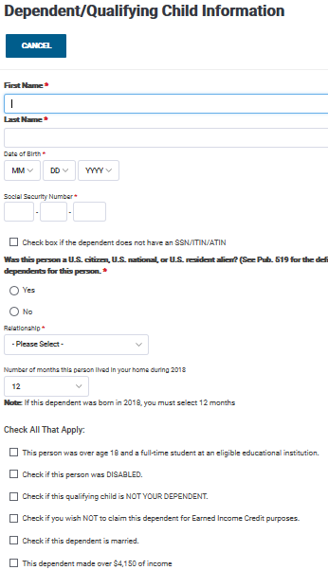
Entering Dependent/QC Information in TaxSlayer
Information entered here will determine if the Age, Relationship, and Residency rules are met. A valid SSN must also be entered for each qualifying child in order to qualify for EIC
Accurate entries for each dependent are essential to ensuring EIC is properly calculated for the return.
Notes:
Note the check box is to NOT CLAIM the dependent for EIC purposes
Class should become familiar with these additional dependent questions as they impact EIC and other tax benefits
They are presented here as not in initial Pub 4012

Slide 19
Quality Review
All qualifying children included on return
Temporary absences
Child providing over half of own support
Permanently disable children or siblings
Prisoner income identified
Schedule EIC and Worksheet complete and correct

Slide 20
Exit Interview
No refunds issued on EIC returns until February 15
Prepare return, E-file and alert taxpayer to refund delay
Advise taxpayer if EIC ending next year
Child over 19 and not full-time student
Over 24 even if full-time student

Slide 21
Earned Income Credit
Questions?
Comments…

Slide 22
Earned Income Credit Comprehensive Topic
EIC Disallowance

Slide 23
EIC Disallowed in Prior Year
Check Intake Booklet
Ask if EIC disallowed in prior year
Must file Form 8862 if other than math error

Slide 24
EIC Disallowed in Prior Year
Check if EIC
reduced or disallowed
ONLY due to
misreported income
Notes:
If EIC denied due to reckless or intentional disregard or EIC rules, taxpayer cannot claim EIC for 2 tax years.
If due to fraud, cannot claim EIC for 10 years.

Slide 25
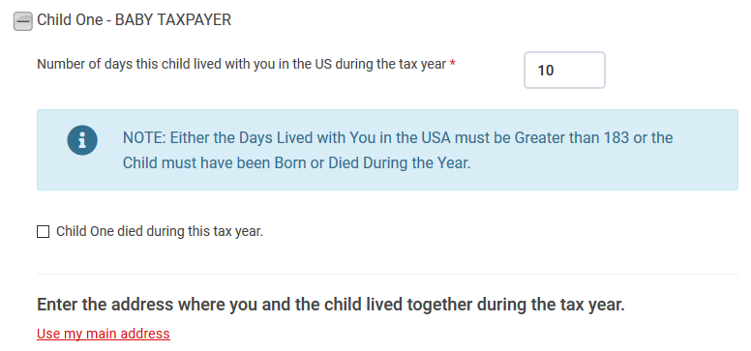
EIC Disallowed in Prior Year
Answer questions for each child separately

Slide 26
Taxpayer Not Eligible for EIC
Enter here if taxpayer is a qualifying child of another taxpayer

